Slide 1

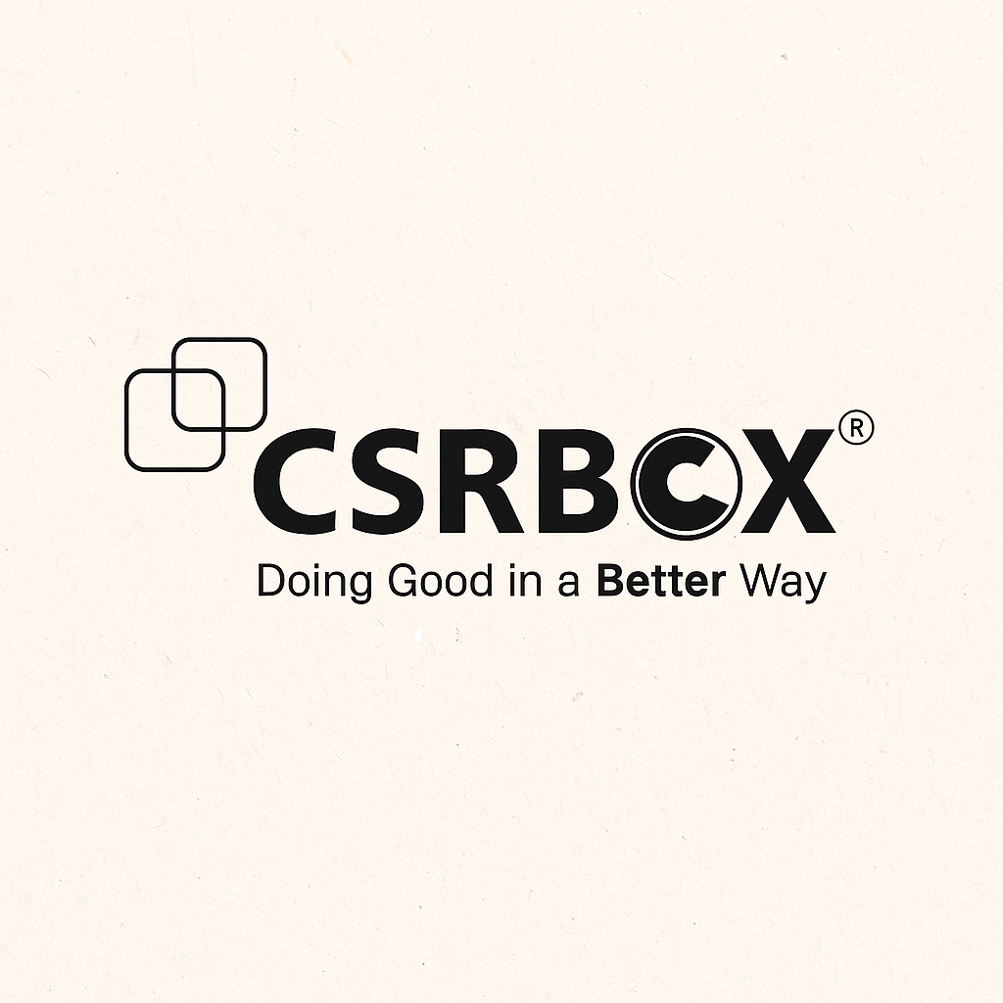
AI/ML
IBM SKILLSBUILD
GEMINI CHATBOT
Development of an SDG 3 RAG-Based Chatbot for Health Guidance
PREPARED BY GROUP NAME GUIDED BY COLLEGE
NILESH DHANKANI THE OPTIMIZERS IBM SKILLS BUILD THE MAHARAJA SAYAJIRAO
PAWAR PARTH UNIVERSITY OF BARODA
SANGADIYA VANDAN
VAGHELA TEJAS

Slide 2
INTRODUCTION
The United Nations' Sustainable Development Goal 3 (SDG 3) focuses on ensuring healthy lives and promoting well-being for individuals of all age groups by reducing health-related risks and improving access to quality healthcare services. Despite growing efforts in public health, significant challenges remain-particularly the limited availability of accurate and reliable health information, and the rapid spread of misinformation from unverified or non-expert sources. To effectively tackle these issues, we propose the development of an intelligent SDG 3 RAG (Retrieval-Augmented Generation) Chatbot. This solution harnesses the power of the Gemini API for natural language understanding and FAISS for high-speed semantic document retrieval. By combining these technologies, the chatbot can deliver timely, verified, and context-specific health answers derived from authentic government and healthcare documents. Furthermore, the chatbot will be deployed using the Streamlit framework, allowing for a seamless and interactive web-based user experience that is accessible to the public, including underserved and remote communities.
.

Slide 3

PROBLEM STATEMENT
OBJECTIVES
The objective is to develop an intelligent chatbot that provides accurate and personalized health information aligned with SDG 3 (Good Health and Well-being).
The chatbot aims to reduce health misinformation by delivering verified, user-specific insights based on medical indicators and user queries.
It will leverage the Google Gemini API and FAISS for Retrieval-Augmented Generation (RAG) to ensure reliable, real-time responses.
SPECIFIC GOALS
Data Collection and Preprocessing
Feature Selections and Engineering
Model Development
Model Evaluation
Implementation and Validation
Ethical and Practical Consideration

Slide 4
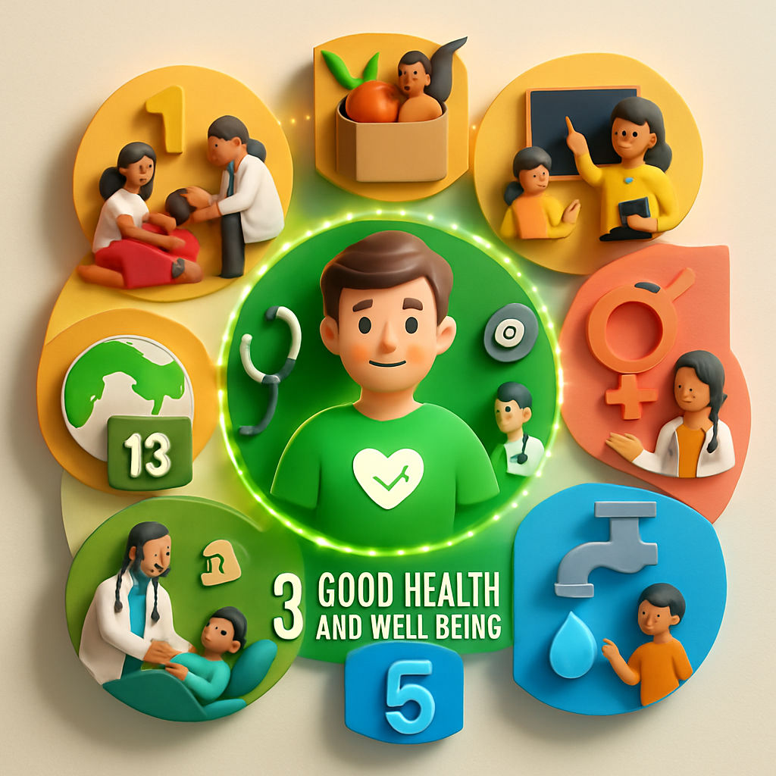
SUSTAINABLE DEVELOPMENT GOAL
GOAL : GOOD HEALTH AND WELL BEING
.
PROBLEM STATEMENT
Lack of accessible health information.
Limitation of traditional systems.
Spread of misinformation
Need for trusted ai solution
PROPOSED SOLUTION
This project develops a RAG-based chatbot using Google Gemini Pro and FAISS, designed to provide accurate, context-aware, and SDG 3-specific responses in a conversational format.

Slide 5

DATA COLLECTION
SOURCES
Who guidelines
Govt health portals and schemes
Health awareness articles
STEPS
Text Cleaning
Segmentation
Structuring
Storage
FEATURE SELCTION
Text Embedding
Vector Indexing
Optimized Retrieval process

Slide 6

MODEL DEVELOPMENT
ALGORITHMS
Sentence-Transformaers
Faiss
Google Gemini Pro Api
.
MODEL TRAINING
No Fine-Tuning Required
RAG Flow Execution
Embedding Pipeline
PARAMETER OPTIMIZATION
Top-k Retrieval
Prompt Engineering

Slide 7
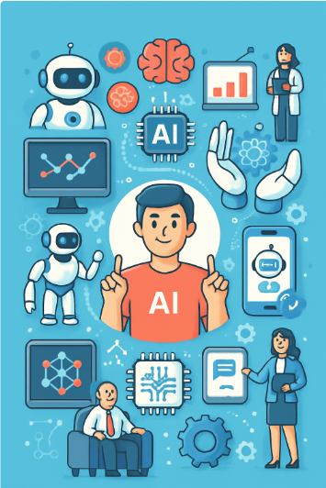
MODEL EVALUATION
Evolution Strategy
Focused on assessing retrieval accuracy, response relevance, and overall user experience of the chatbot.
Used realistic user queries related to SDG 3 (Good Health and Well-being) for testing the system.
Since the model uses pre-trained components, there was no traditional supervised training or labeled datasets involved.
Since the model uses pre-trained components, there was no traditional supervised training or labeled datasets involved.
Performed manual evaluation to inspect the quality of both document retrieval and generated responses.
Ensured all responses were factually consistent, grounded in the curated health documents
Prioritized clarity and simplicity in answers to make them understandable for non-technical users.

Slide 8
PYTHON
STREAMLIT
SENTENCE TRANSFORMER
NUMPY
FAISS
HEALTH DOCUMENTS
GITHUB
GOGLE DOCS
RAG
TOOLS
AND
RESOURCES
.

Slide 9
MODEL IMPACT AND EFFECTIVENESS
Health Awareness & Accessibility
Provided users with accurate, document-backed answers on health schemes and wellness, enhancing trust and clarity.
Empowered individuals in remote or underserved regions with better understanding of SDG 3 topics like disease prevention, nutrition, and mental health.
Reliability & Safety of AI Responses
Provided users with accurate, document-backed answers on health schemes and wellness, enhancing trust and clarity.
Empowered individuals in remote or underserved regions with better understanding of SDG 3 topics like disease prevention, nutrition, and mental health.
Health Awareness & Accessibility
Achieved strong semantic relevance and quick response times using FAISS and sentence-transformers for efficient document matching.
Empowered individuals in remote or underserved regions with better understanding of SDG 3 topics like disease prevention, nutrition, and mental health.
.

Slide 10


HOW IT WILL WORK
User Query Ingestion
A user submits a natural language query via the Streamlit-based web interface.
Semantic Retrieval using FAISS
A user submits a natural language query via the Streamlit-based web interface.
Prompt Construction and RAG-based Augmentation
by combining the user's query with top-matching document snippets and sent securely to Gemini Pro, which generates a fact-based, grounded response.
Response Delivery and UI Rendering
The LLM-generated response is parsed and displayed in real-time on the Streamlit frontend.

Slide 11
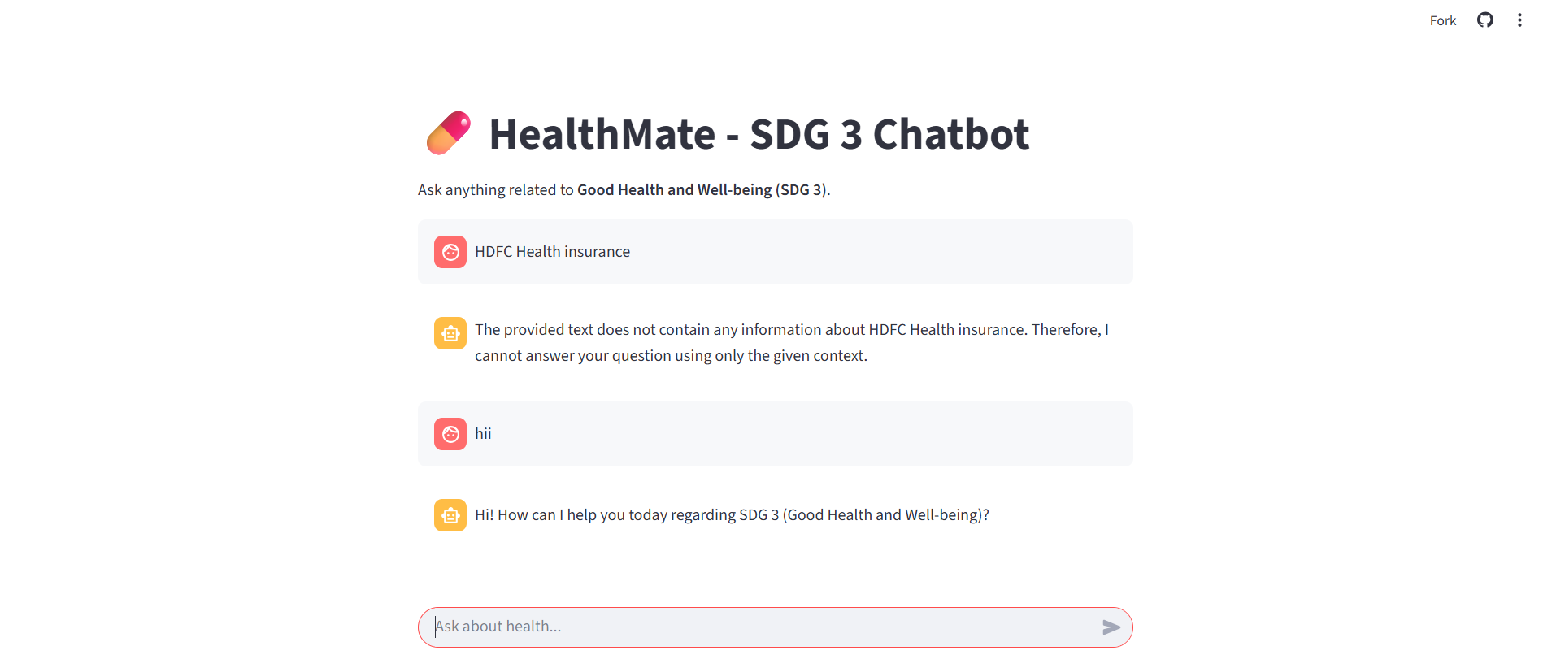
User Interface
.
The chatbot interface allows users to ask personalized queries related to SDG 3 (Good Health and Well-being), delivering context-aware, document-backed responses.
If relevant information is not found in the indexed documents, the system transparently notifies the user, ensuring factual reliability and minimizing hallucinated answers.

Slide 12
Conclusion
HealthMate – SDG 3 Chatbot is a great example of how technology, especially artificial intelligence, can be used to support public health. By combining smart document search with natural language understanding, the chatbot delivers quick and reliable answers based on real government health resources.
What makes this tool especially meaningful is its potential to bridge the digital gap. It helps people-particularly in rural or underserved communities-access trustworthy information about health programs, nutrition, mental wellness, and government policies that they might otherwise struggle to find.
At its core, HealthMate supports the global goal of Good Health and Well-being (SDG 3), by making health knowledge easier to access, reducing the spread of misinformation, and encouraging informed, healthy choices for everyone.
.

Slide 13

FOR WEBSITE
https://healthmate-chat-bot.streamlit.app/

Slide 14
FOR SOURCE CODE
https://github.com/nileshdhankani/HealthMate-Chatbot

